Slide 1
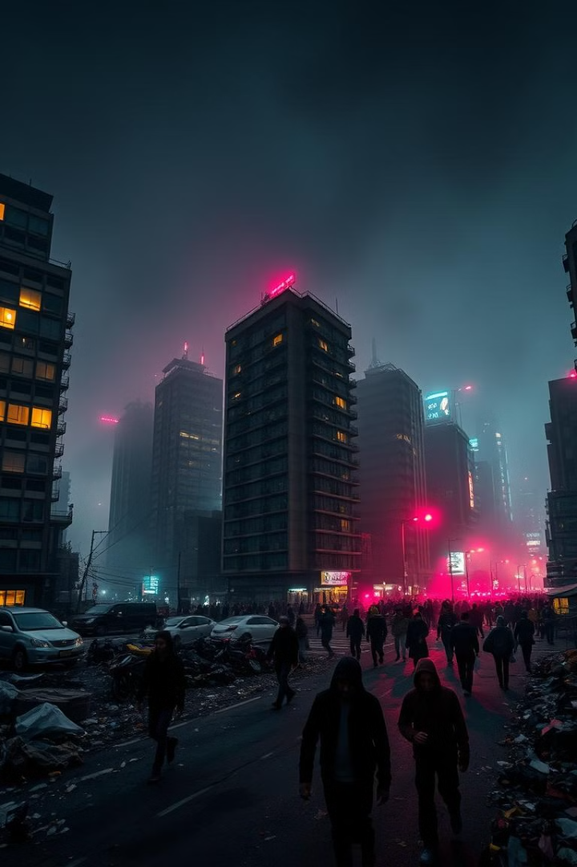
Environment Pollution
Presented by Faiyaz Ahmed

Slide 2
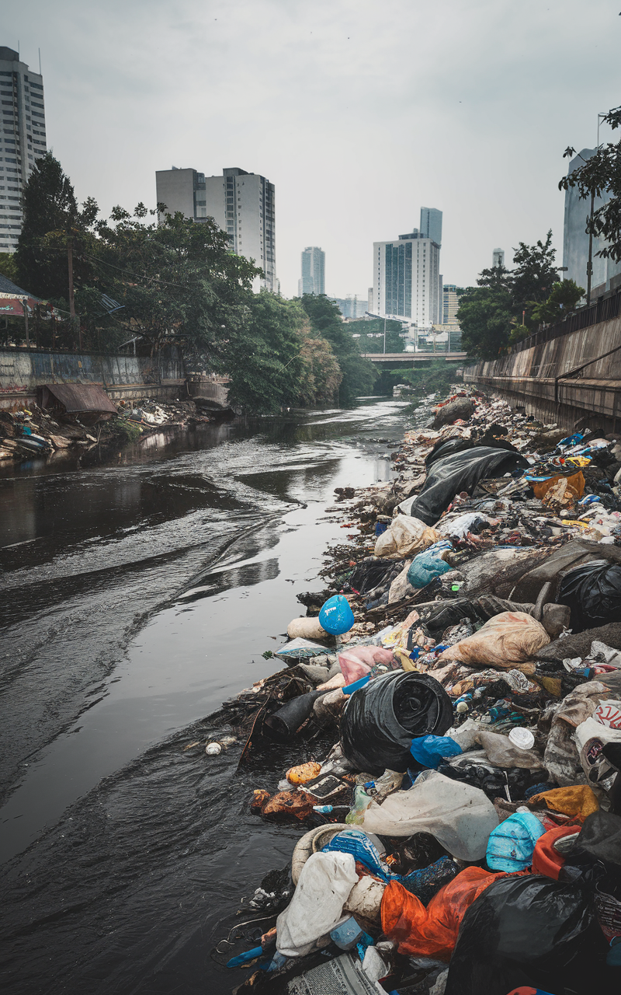
Introduction
Environmental pollution is a critical issue that affects every aspect of our planet and human health. It occurs when harmful substances—known as pollutants—are introduced into the natural environment, leading to adverse changes in air, water, and soil quality. The major sources of pollution include industrial activities, agricultural practices, transportation, and waste disposal. As urbanization and industrialization continue to grow, the scale and complexity of pollution have escalated, posing significant challenges to ecosystems and public health. Understanding the causes, effects, and solutions to environmental pollution is essential for promoting a sustainable future and ensuring the well-being of generations to come.

Slide 3
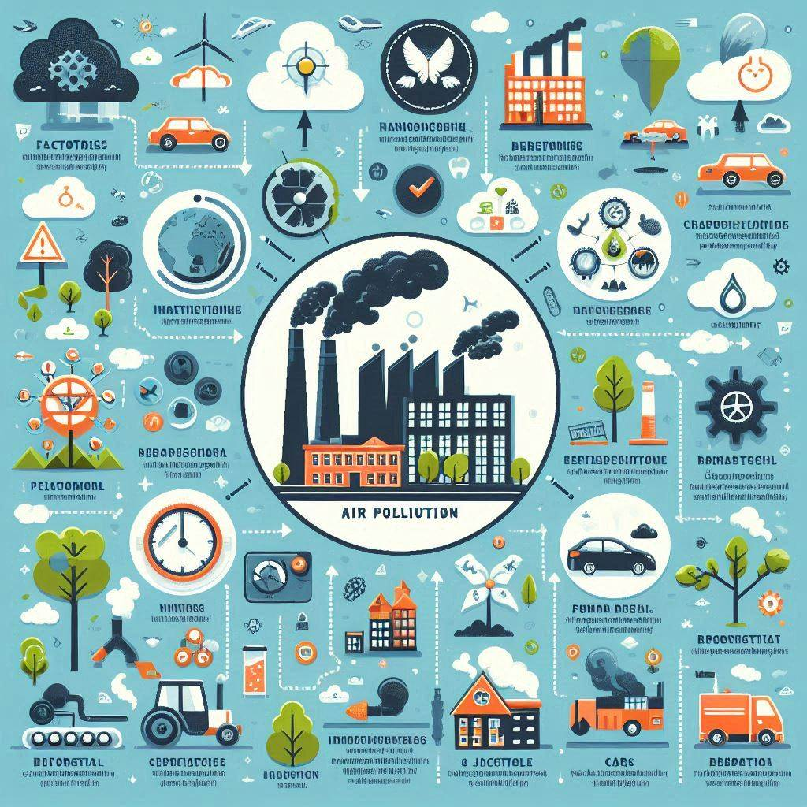
Air Pollution
Air pollution refers to the presence of harmful substances in the atmosphere, including gases, particulates, and biological molecules, that pose health risks to humans and other living organisms. Common sources of air pollution include vehicle emissions, industrial activities, burning of fossil fuels, and agricultural activities. Pollutants such as carbon monoxide (CO), sulfur dioxide (SO₂), nitrogen oxides (NOₓ), and particulate matter (PM) contribute to respiratory issues, cardiovascular diseases, and can exacerbate conditions like asthma.

Slide 4
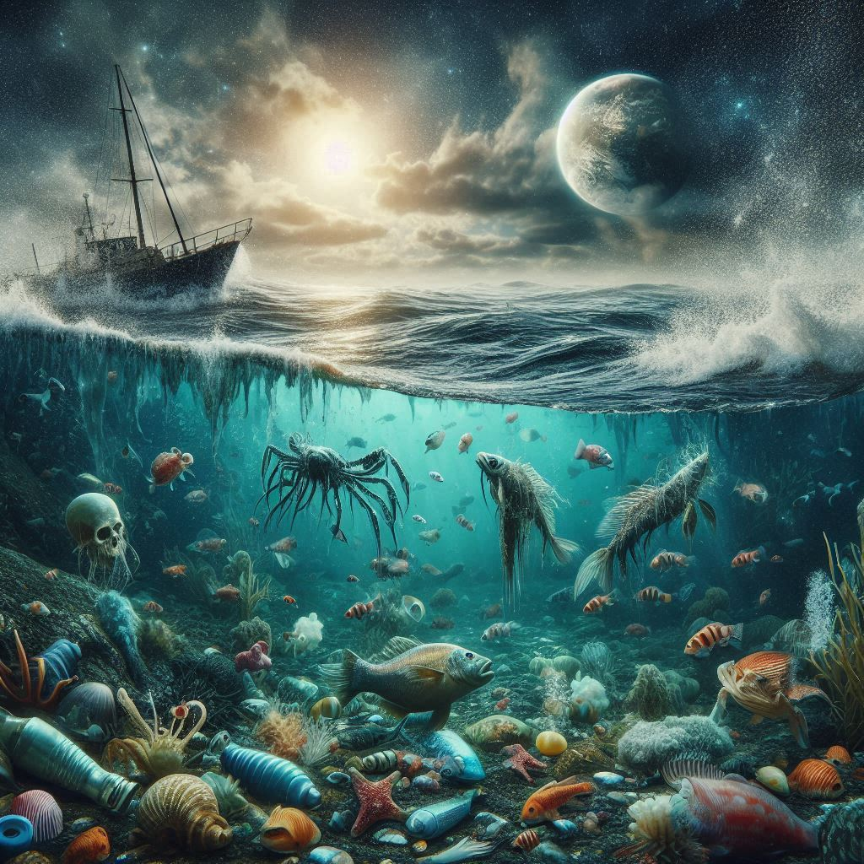
Water Pollution
Water Pollution: Impact on Marine Life and Human Health
Caused by harmful chemicals, plastics, and sewage entering water bodies.
Major sources: industrial waste, agricultural runoff, and plastic pollution.
Damages marine ecosystems and reduces biodiversity.
Causes health issues like gastrointestinal diseases and reproductive problems in humans.

Slide 5
Soil Pollution: Sources, Effects, and Prevention

Slide 6
Soil Pollution: Sources, Effects, and Prevention
Flowchart
Sources → Effects → Prevention
Sources
Agricultural
Waste disposal
Effects
Health Risks
Industry
Prevention
Reduced Soil Fertility
Organic Farming
Waste Management

Slide 7
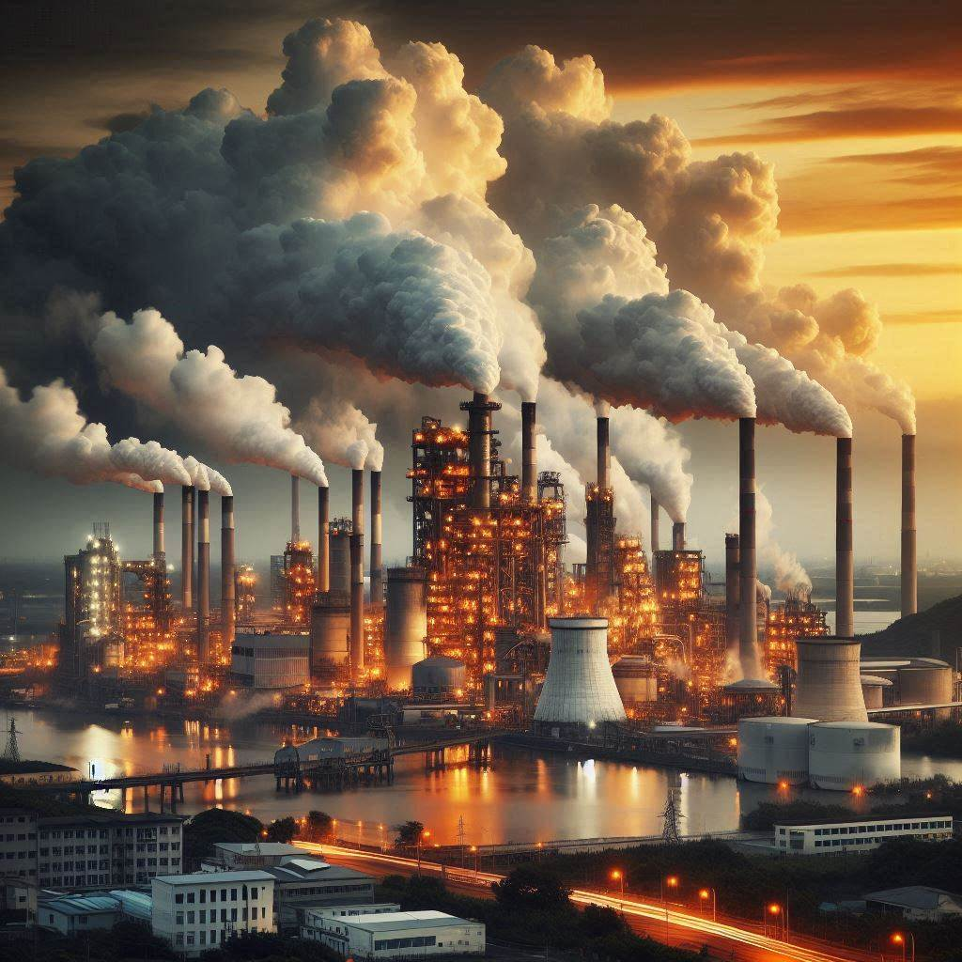
Industrial Pollution: Managing and Mitigating Its Effects
Industrial pollution is caused by the release of harmful substances like chemicals, gases, and heavy metals from manufacturing and production processes. It leads to air, water, and soil contamination, posing risks to both human health and the environment. Industrial waste can cause respiratory issues, waterborne diseases, and long-term environmental damage. Managing industrial pollution involves using cleaner technologies, implementing stricter regulations, and adopting sustainable practices like waste recycling and emissions control to reduce its impact.

Slide 8
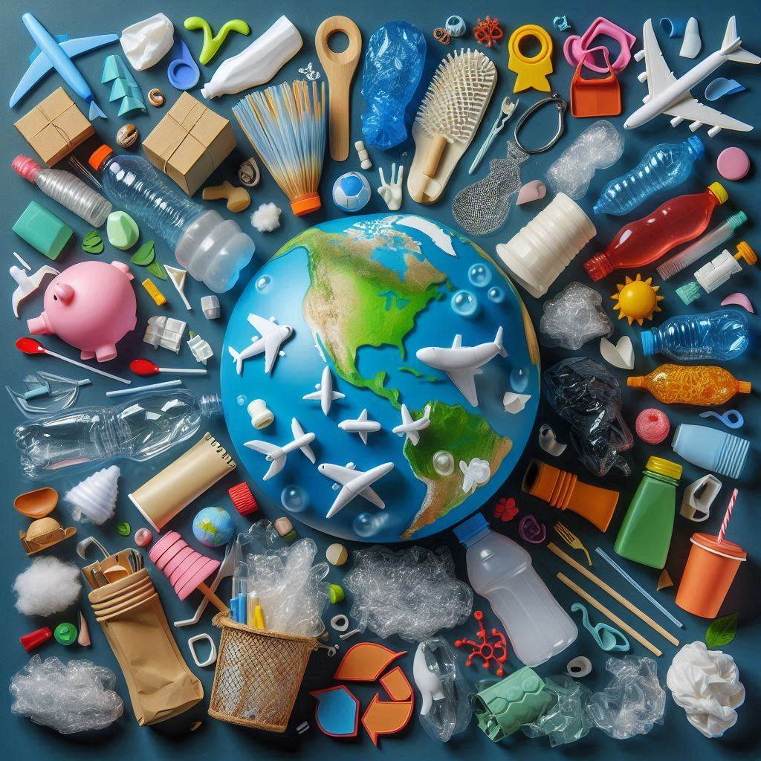
Plastic Pollution: Strategies for Reduction and Management
Sources: Single-use plastics, packaging materials, and discarded plastic products.
Impact: Harms marine life, disrupts ecosystems, and contributes to microplastic contamination.
Health Concerns: Linked to hormone disruption and ingestion of toxins in humans and animals.
Waste Accumulation: Plastic waste is non-biodegradable and remains in the environment for centuries.
Reduction Strategies: Banning single-use plastics, promoting reusable alternatives, and implementing recycling programs.
Management: Developing biodegradable plastics, enhancing waste collection systems, and increasing public awareness.

Slide 9

Noise Pollution: Health Effects and Control Measures
Source of Noise Pollution | Health Effects | Control Measures
Traffic and Transport | Hearing loss, stress, sleep disturbances | Sound barriers, better road design
Industrial Activities | Cardiovascular issues, hypertension | Noise-reducing equipment, zoning laws
Construction Sites | Irritability, anxiety, reduced productivity | Time restrictions, use of quieter machines
Urbanization (Residential Noise) | Concentration problems, mental fatigue | Green spaces, better building materials
Entertainment (Loud Music, Events) | Tinnitus, headaches | Noise limits, public awareness campaigns

Slide 10

Noise Pollution
1
Health Effects
Stress, sleep issues, heart disease, hearing loss.
2
Control Measures
Noise barriers, quiet zones, stricter regulations.

Slide 11

Light Pollution
Ecosystem Impact
Disrupts wildlife circadian rhythms.
Solutions
Shielded lighting, reduced outdoor illumination.

Slide 12
E-Waste Pollution
Challenges
Recycling
Hazardous substances, environmental contamination.
Comprehensive programs, responsible consumption.

Slide 13



Agricultural Pollution
Pesticides/Fertilizers
Soil degradation, water contamination.
Sustainable Farming
Crop rotation, organic farming.

Slide 14
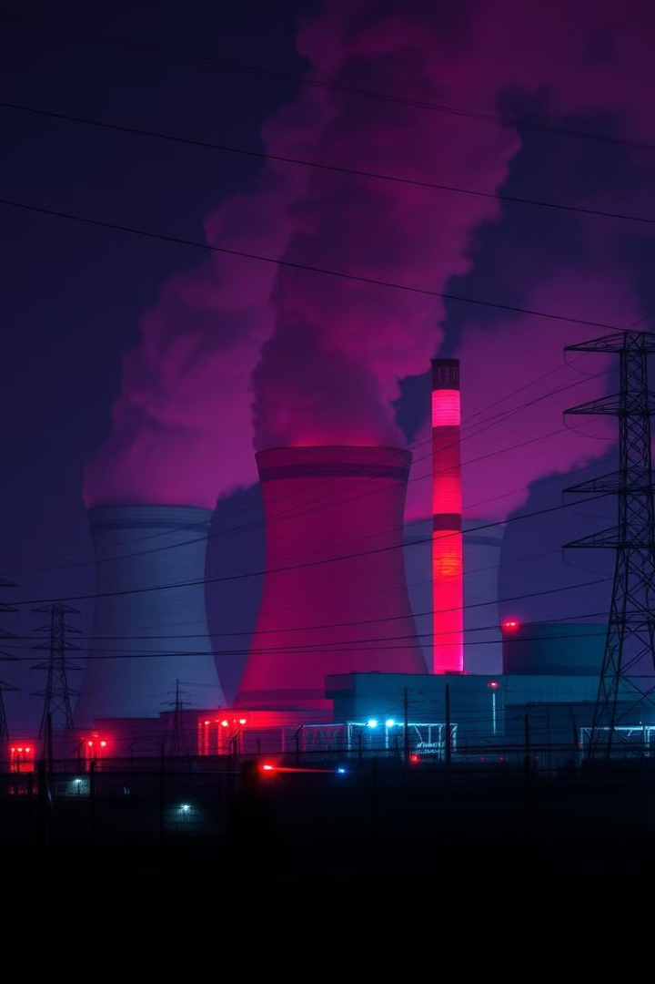
Radioactive Pollution
Sources
Nuclear waste, medical waste, mining.
Effects
Cancer, genetic mutations.

Slide 15

Urbanization & Pollution
1
2
3
Increased Waste
Air/Water Pollution
Habitat Loss
More waste generation.
Higher pollution levels.
Destruction of natural habitats.

Slide 16



Climate Change & Pollution
Greenhouse Gases
Contribute to climate change.
Renewable Energy
Reduce emissions.

Slide 17
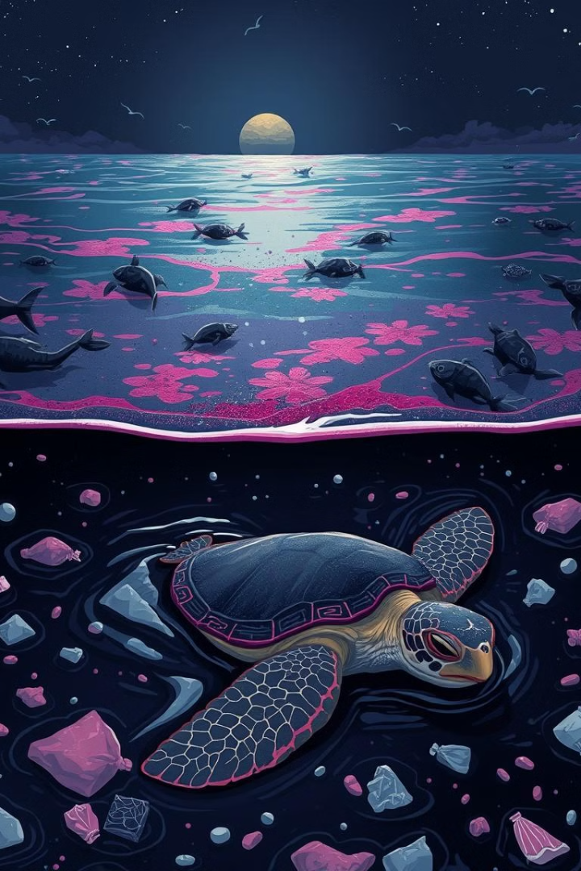
Ocean & Mining Pollution
1
Ocean Pollution
Oil spills, chemical contaminants.
2
Mining Pollution
Habitat destruction, water contamination.

Slide 18
Microplastics & Air Quality
Microplastics
Air Quality
Harm marine life, affect human health.
Urban smog, respiratory issues.

Slide 19
CO₂ Emissions: Cutting trees releases stored carbon, increasing greenhouse gases.
Soil Erosion: Deforestation leads to soil loss and sedimentation in water bodies.
Water Cycle Disruption: Trees regulate rainfall; their loss can cause flooding.
Biodiversity Loss: Deforestation destroys habitats, threatening species survival.
Air Pollution: Burning forests releases harmful pollutants, affecting air quality.
Impact on Communities: Indigenous people are displaced and lose livelihoods.
Climate Change: Reduces CO₂ absorption, worsening climate change effects.
Deforestation and Its Contribution to Environmental Pollution

Slide 20
Governments:
Regulation and Legislation: Enforce environmental laws.
Pollution Control Programs: Reduce emissions and promote clean technologies.
Funding and Support: Budget for research and incentives for eco-friendly practices.
Public Awareness Campaigns: Educate citizens on pollution sources.
International Agreements: Engage in global treaties to address pollution.
Role of Governments in Combating Pollution

Slide 21
NGOs:
Advocacy and Awareness: Raise awareness and advocate for environmental protections.
Research and Monitoring: Provide data to support policy changes.
Community Engagement: Promote sustainable practices at the local level.
Collaborative Projects: Partner with various stakeholders for pollution reduction.
Legal Action: Hold polluters accountable through legal means.
Role of NGOs in Combating Pollution

Slide 22
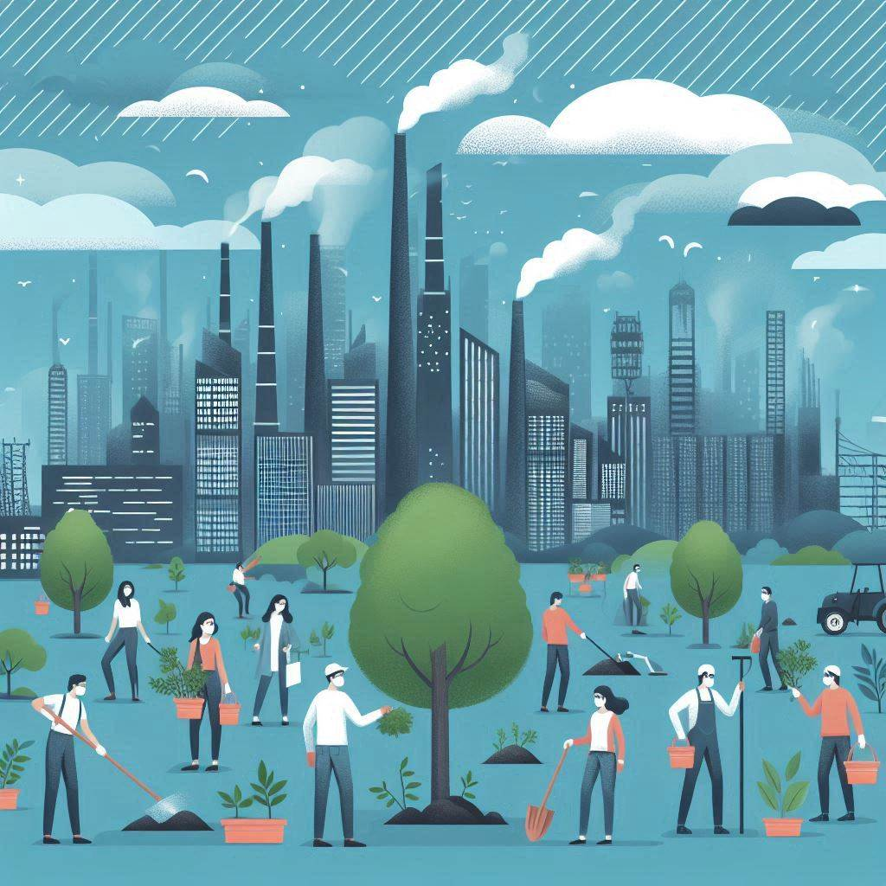
Conclusion
In conclusion, environmental pollution remains one of the most pressing challenges facing our planet today. Its far-reaching impacts affect not only natural ecosystems but also human health, biodiversity, and climate stability. Combating pollution requires a collective effort from governments, non-governmental organizations, businesses, and individuals to implement effective policies, promote sustainable practices, and raise awareness. By fostering collaboration and commitment to environmental stewardship, we can mitigate pollution's effects and work towards a cleaner, healthier, and more sustainable world for all. The urgency of this issue calls for immediate action, as the health of our environment directly influences the quality of life on Earth.

Slide 23
Thank you

